Slide 1
IoT Monitoring Dashboard Capstone Project — Milestone Progress Update
Program BAS Application Development
Course CSI-492 Senior Capstone Project
Student Quoc Bao Tran Date 6/14

Slide 2
Schedule Update Status: On track
Project Progress Update
Time Period | Dates |  | Focus |  | Status/Progress Update
Week 1–2 | 4/6 – 4/19 |  | Planning — project charter, requirements, architecture |  | Project charter approved; requirements documented; architecture defined (MQTT → API → SQL → SignalR → React).
Week 3–4 | 4/20 – 5/3 |  | Data — SQL Server schema, EF Core entities, migrations, seed/test data |  | SQL schema designed; EF Core entities & migrations applied; seed/test data loaded.
Week 5–6 | 5/4 – 5/17 |  | Backend — repositories, services, REST API, MQTT ingest, command dispatch, SignalR, alerts. |  | Repositories & services implemented; REST API live; MQTT ingest & command dispatch working; SignalR hub & alert evaluation connected.
Week 7–8 | 5/18 – 5/31 |  | Frontend — React dashboard, auth, live charts, devices, commands, alerts UI |  | React dashboard built; JWT auth integrated; live charts via SignalR; device, command, and alert pages functional.
Week 9–10 | 6/1 – 6/14 |  | Integration & testing — Arduino ↔ Mosquitto ↔ API ↔ SQL ↔ SignalR ↔ UI (end-to-end) |  | End-to-end pipeline verified: Arduino → Mosquitto → API → SQL → SignalR → UI; issues logged and fixed.
Week 11 | 6/15 – 6/19 |  | Documentation & presentation — final docs, polish, demo prep → Final presentation 6/17

Slide 3
Milestone 6/1-6/14 (week9 &10)
Goal: Verify the full system works together — hardware/simulator through MQTT and API to SQL and the React dashboard, with real-time updates, commands, and alerts.
Status: Completed
Completed work:
Ran end-to-end pipeline test: Arduino/simulator → Mosquitto → MqttService → SQL → SignalR → React charts
Executed automated API tests (Run-ApiTests.ps1) — passed (health, auth, REST CRUD, readings)
Completed manual test checklist — login, dashboard, devices, live charts, commands, alerts, roles
Verified SignalR live updates without page refresh (readings and alerts)
Verified MQTT ingest — published reading appears in DB and on dashboard
Verified command flow — UI command → MQTT → command status/history updates
Logged and fixed integration issues (chart trim, SignalR reconnect, device/sensor ID alignment)
Updated test docs: MANUAL_TEST_CHECKLIST.md, AUTOMATED_TEST_RESULTS.md
Progress (schedule table): End-to-end pipeline verified; automated and manual tests run; issues logged and fixed.

Slide 4
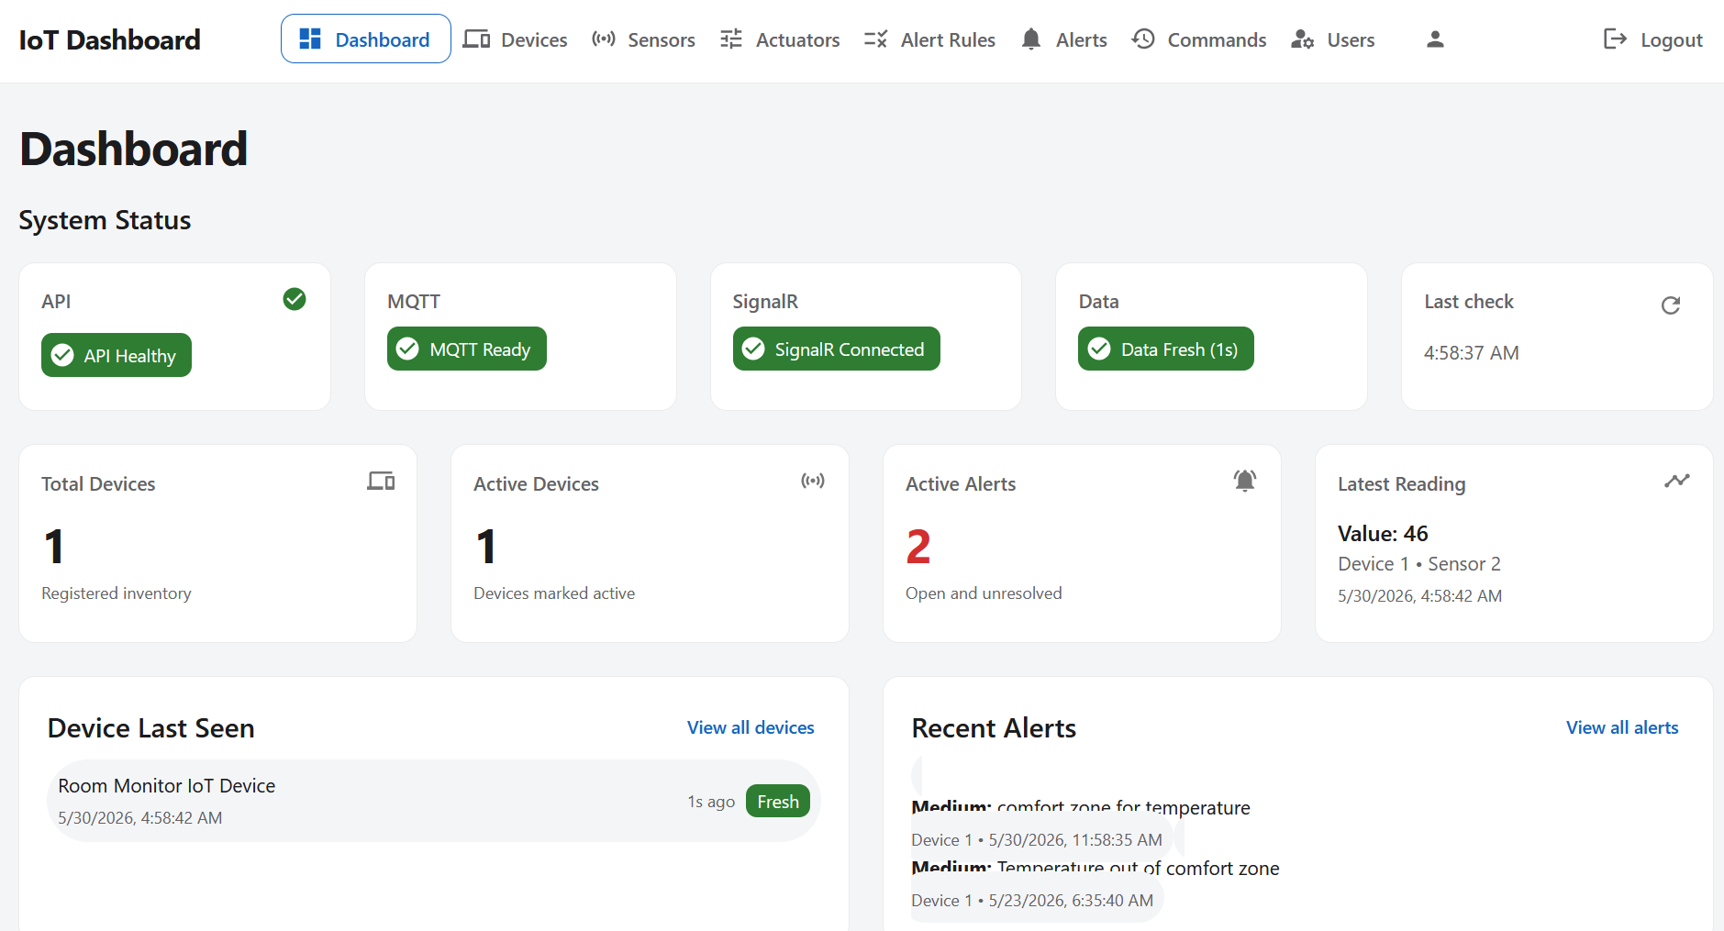
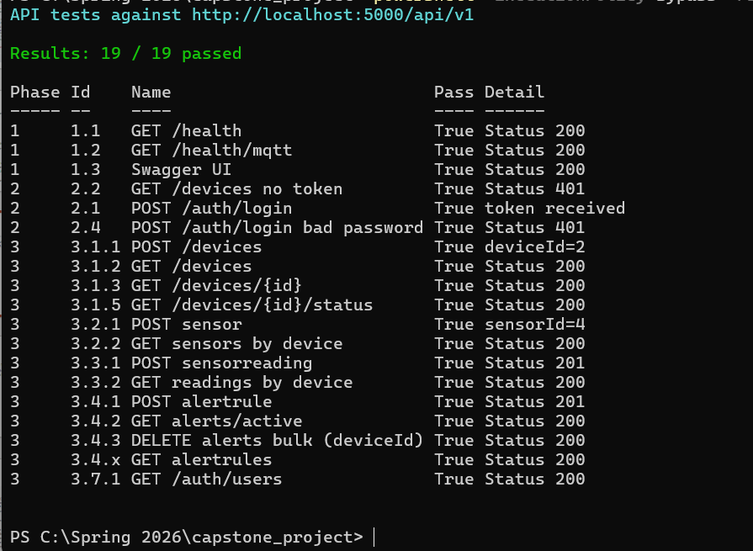
Evidence / screenshots
Fig. 1 — Full stack
Fig. 2 — MQTT → DB → UI
Screenshot: dashboard showing API / MQTT / SignalR connected
Screenshot: API test results

Slide 5
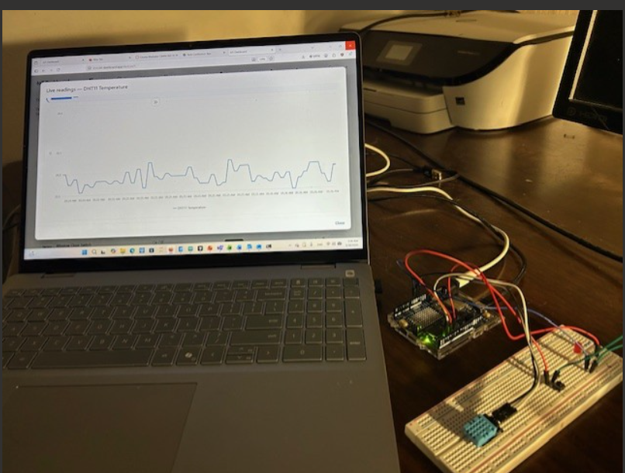
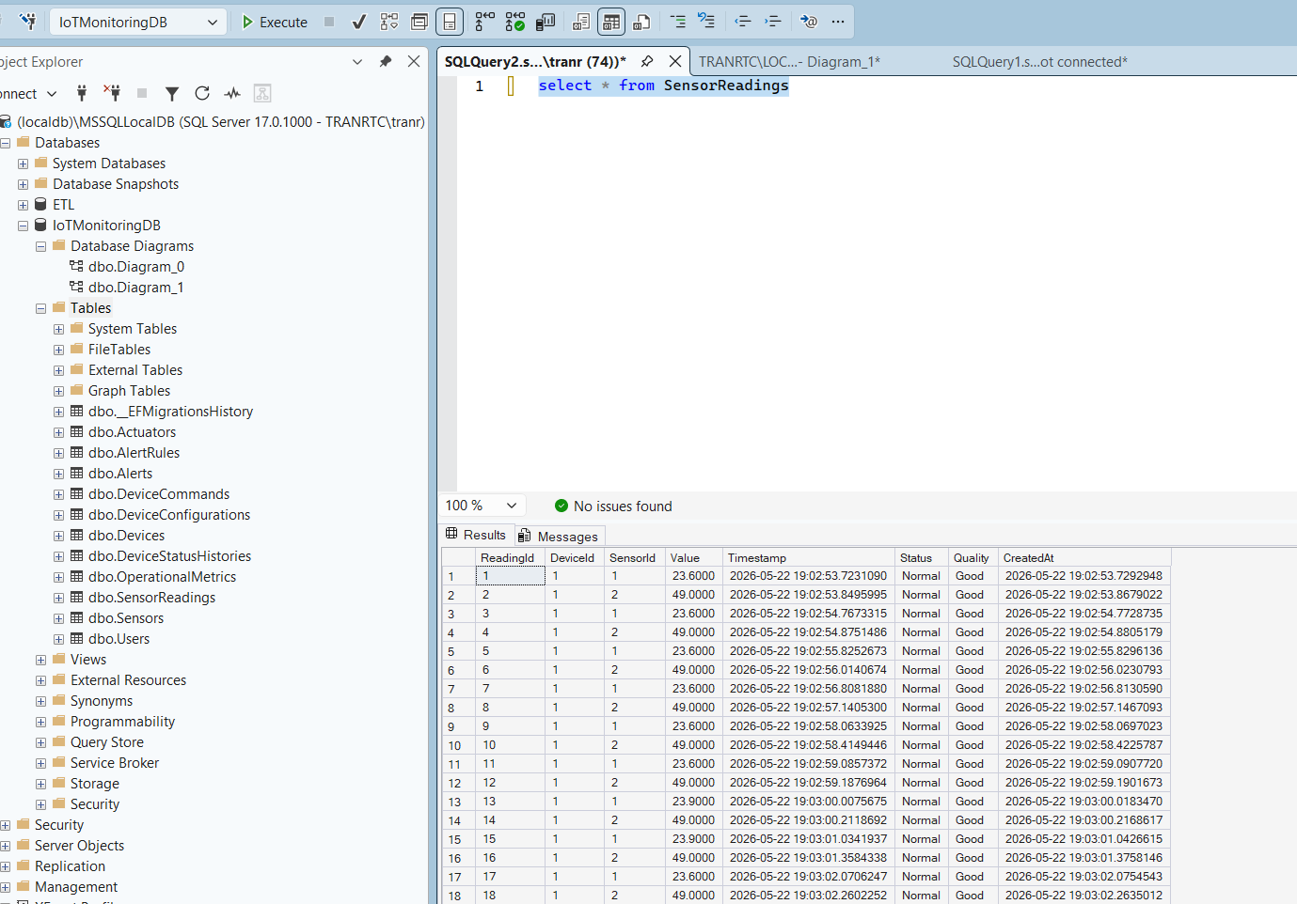
Evidence / screenshots
Fig. 4 — Hardware
Fig. 3 — Testing
Photo/screenshot: Arduino Uno Wifi + MQTT publish + UI update
Screenshot: reading in SQL + same value on live chart

Slide 6
Problems & solutions
Problem | Solution
Reading in MQTT but not in UI | Checked topic format devices/{id}/sensors/{id}/readings and DB device/sensor IDs matched Arduino constants
SignalR dropped after API restart | Confirmed UI reconnects; retested in manual checklist
Live chart scroll failed (value, no line) | Fixed time-window trim and live-mode handling; retested
Command sent but status stuck | Verified mqtt broker: Mosquitto
Test environment setup inconsistent | Documented prerequisites (API, frontend, MQTT, SQL) in manual checklist

Slide 7
Barriers
Extra time needed for integration testing and debugging
No major barriers — project on track for final presentation

Slide 8
Reflection & next steps
Learned: Integration bugs appear at boundaries (MQTT topics, IDs, time zones, SignalR); a written checklist catches issues single-component tests miss.
Next (Week 11): Final documentation, UI/demo polish, presentation rehearsal → Final presentation: 6/17.

